Slide 1
Creating a tobacco free NHS:
The national smokefree NHS grounds campaign
Jane Hoeflich
Senior Marketing Manager
NHS Health Scotland

Slide 2
Contents
1
Background
Campaign objective
2
Stages of planning
3
Audience and insight
4
Development
5
Outputs
6
7
Evaluation results
8
Contacts

Slide 3


Background
Political
National and Local
Collaboration
1
2
3

Slide 4
Campaign objectives
Raise mass awareness
Explain the priority
Communicate the parameters

Slide 5
Timeline of activities
November
Agencies commissioned and briefed
Desk research
December
Script development
January
Insight gathering and pre-test
Pre-wave campaign evaluation
February
Filming of TV advert, recording of radio advert and build of microsite
March
Ministerial launch and campaign on air
October
Agreement to proceed
April
Post-wave evaluation

Slide 6
Audience segmentation
All smokers
Heavy smokers (20+ a day)
an Male and female
Social demographic of C2DE
25-44 and 55-64.

Slide 7


20.2% of adults in Scotland smoke
132,000 heavy smokers, c2de 25-44 and 55-64’s in scotland
894,000 Smokers
588,000
C2DE Smokers
305,000
C2DE Heavy Smokers
46,000
55-64 C2DE
Heavy
Smokers
86,000
25-44 C2DE
Heavy Smokers
Source: TGI GB Jul’13-Jun’14, base adults 15+, “Heavy Smokers” about 20+ per day

Slide 8







TOPLINE MEDIA CONSUMPTION
Key media are tv, radio, popular press, online and OOH for younger end of TA
 | TELEVISION | RADIO | QUALITY NEWSPAPER | MID-MARKET NEWSPAPER | POPULAR NEWSPAPER | GENERAL MAGAZINES | INTERNET | OUTDOOR | CINEMA
C2DE 25-44 HEAVY SMOKERS | HEAVY | HEAVY/ MEDIUM | NONE | NONE | HEAVY/ MEDIUM | HEAVY | HEAVY | HEAVY | LIGHT
C2DE 55-64 HEAVY SMOKERS | HEAVY | HEAVY/ MEDIUM | NONE | NONE | HEAVY | MEDIUM | LIGHT | MEDIUM | NONE
Source: TGI GB Jul’13-Jun’14, base adults 15+, “Heavy Smokers” about 20+ per day

Slide 9
Existing NHS Boards activity
Add imagery from local work

Slide 10
Insight and pre-testing
7 extended mini groups (two hours 4-5 respondents)
General public sample (all smokers)
Male and female, 24-64, C2DE
All smokers (not vaping) at least 20 cigarettes a day
All to have smoked on NHS grounds in the last year
Some to have smoked on hospital grounds (in last year)

Slide 11
Attitudes to smoking
Impact of smoking ban accepted
Greater understanding of the dangers of second hand smoke
Greater sensitivity to diminishing social acceptability

Slide 12
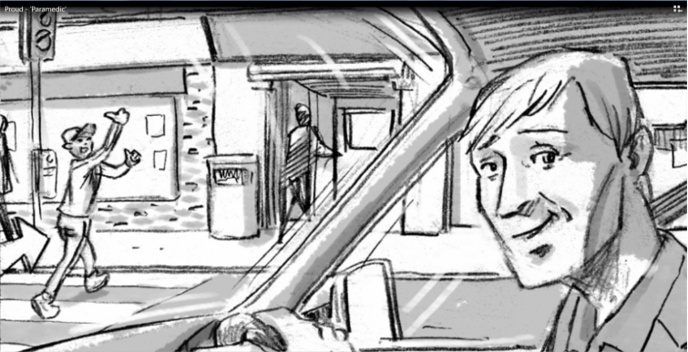
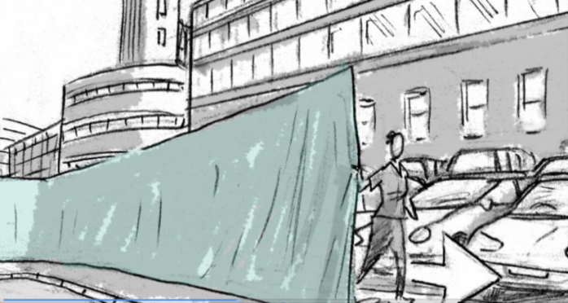
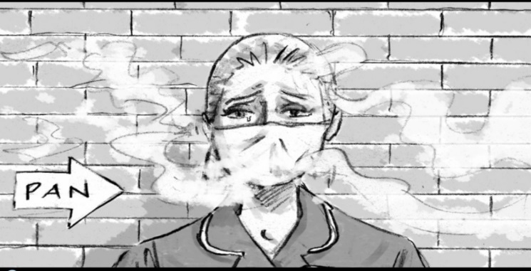
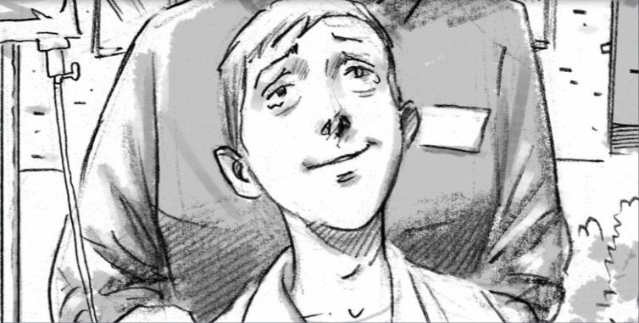
Four script options

Slide 13
Pre-test results (resonance)
“They’re trying to protect everybody’s health…”
(Female, DE, 55-64)
“It’s very factual: this is where the line is drawn…so as soon as you step over onto NHS ground.” (Male, C2D, 25-44)
“It’s looking for buy-in. It’s looking for you to be a part of it, rather than telling you…‘you will not!’” (Male, C2D, 25-44)
Requesting rather than demanding

Slide 14
Pre-test results (creative reaction)
Curtain device was effective in marking out physical boundary
Nurse humanised the factual communication
Talked directly to the viewer
Appealed to the viewers better nature

Slide 15
Development
TV advert
Radio advert
Campaign microsite
Digital assets and plasma screens
Poster using Web2Print technology
PR Toolkit

Slide 16
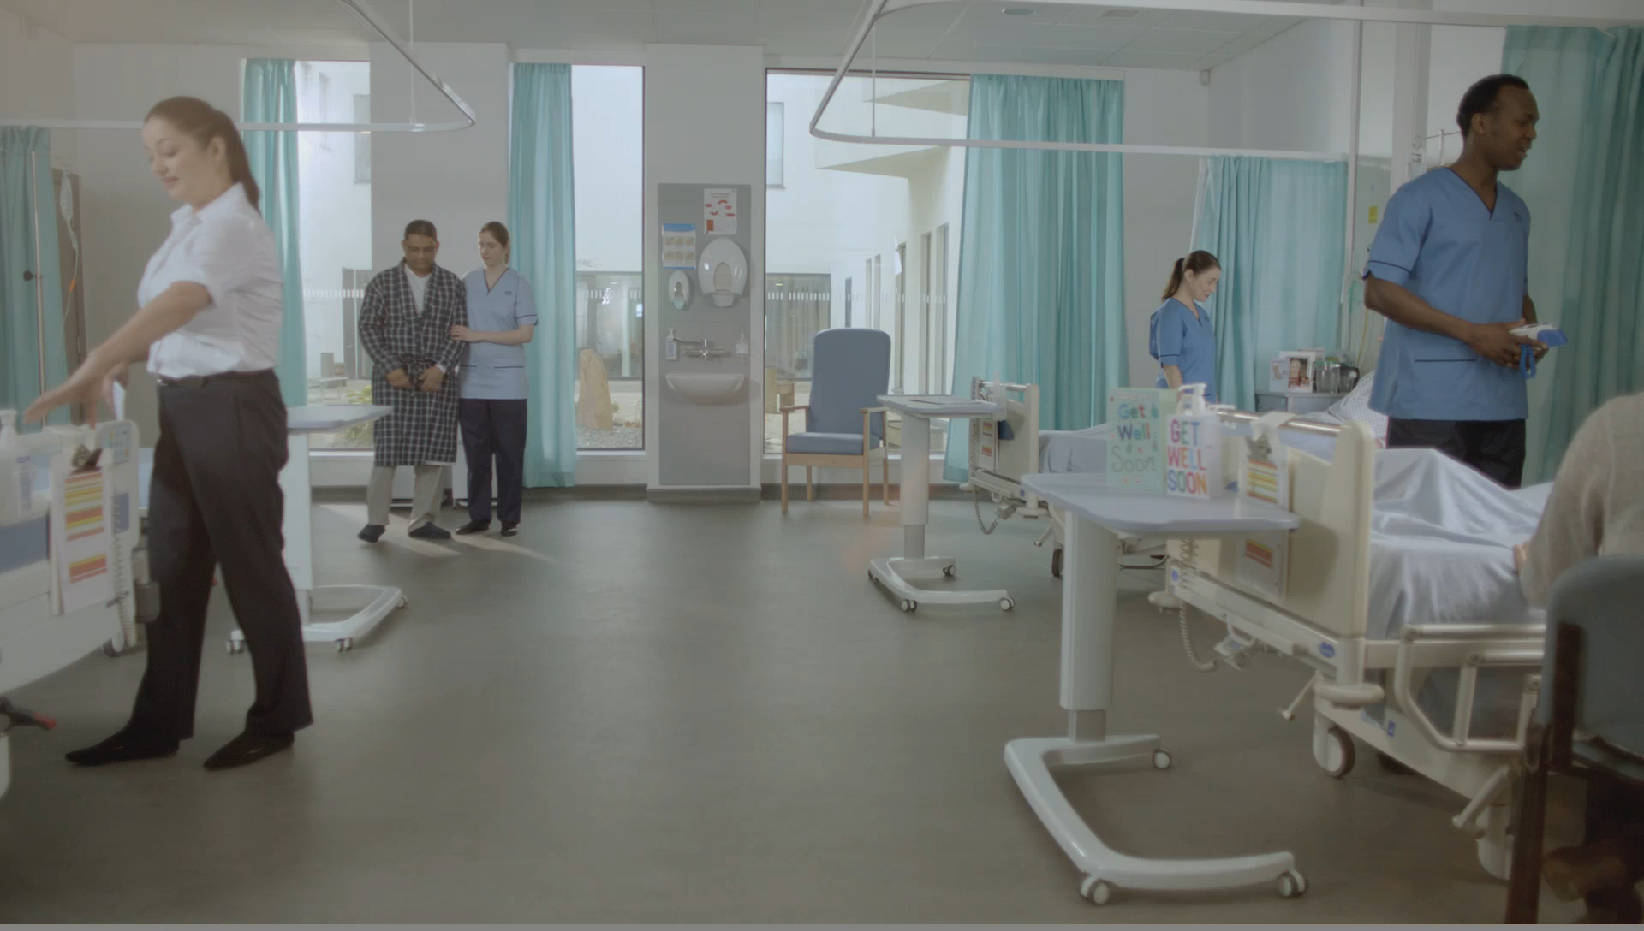
Green Curtain

Slide 17
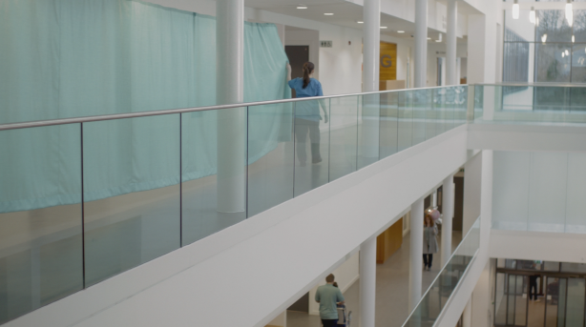
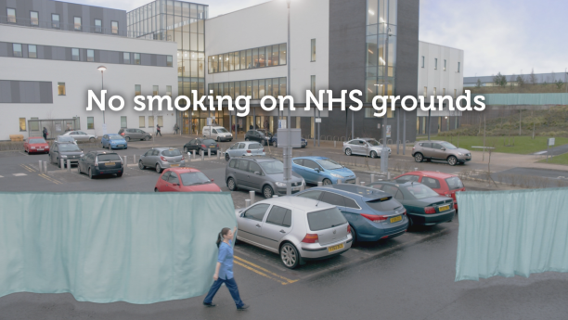
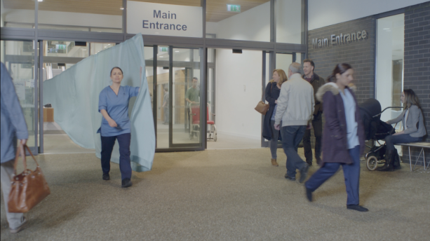

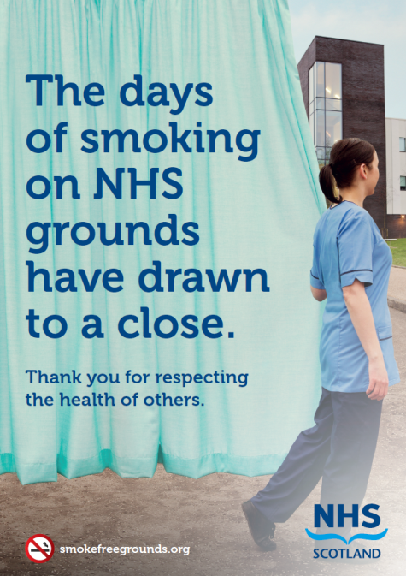
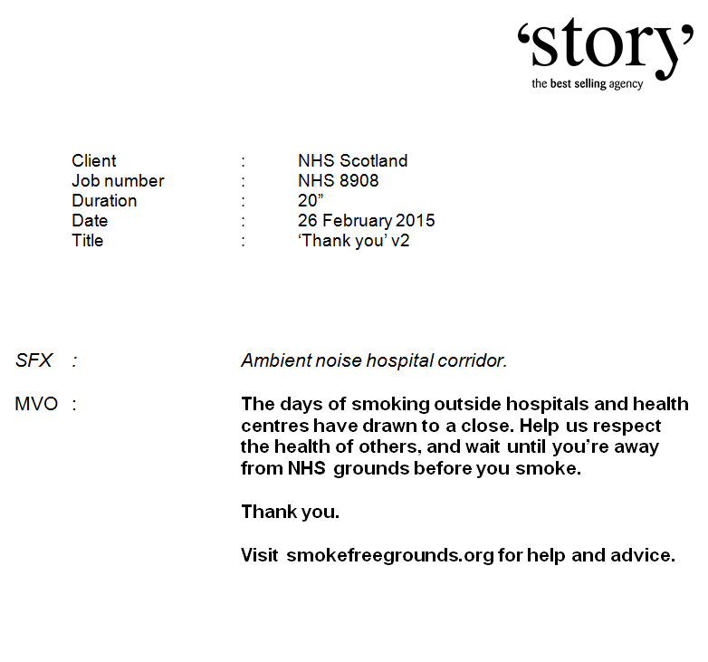
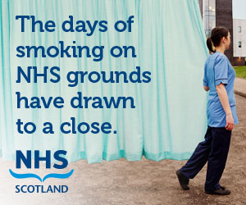

Creative Overview
TV
Master poster/print execution
Radio
Online banners

Slide 18
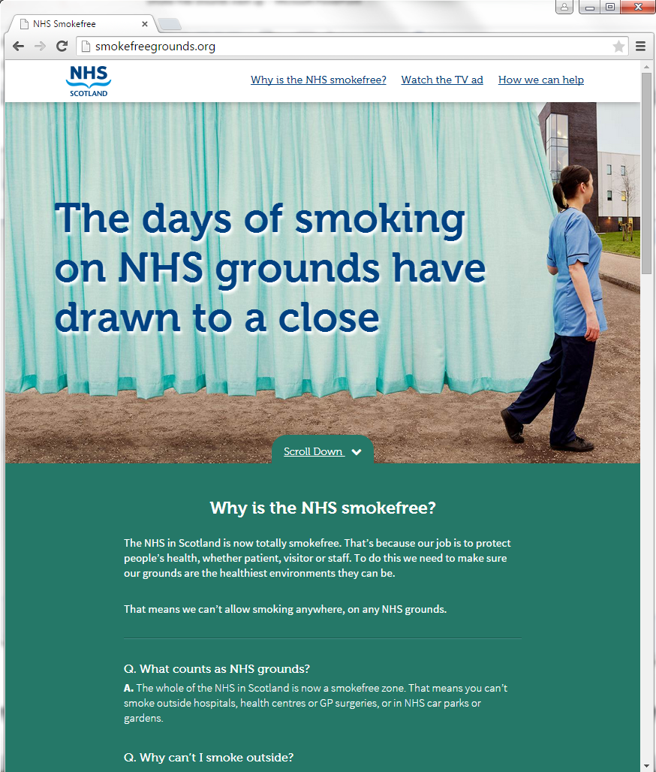
Website creative
Succinct one-stop-shop web page for anyone looking for more information
Simply a place to host FAQs and an opportunity to signpost to cessation services

Slide 19
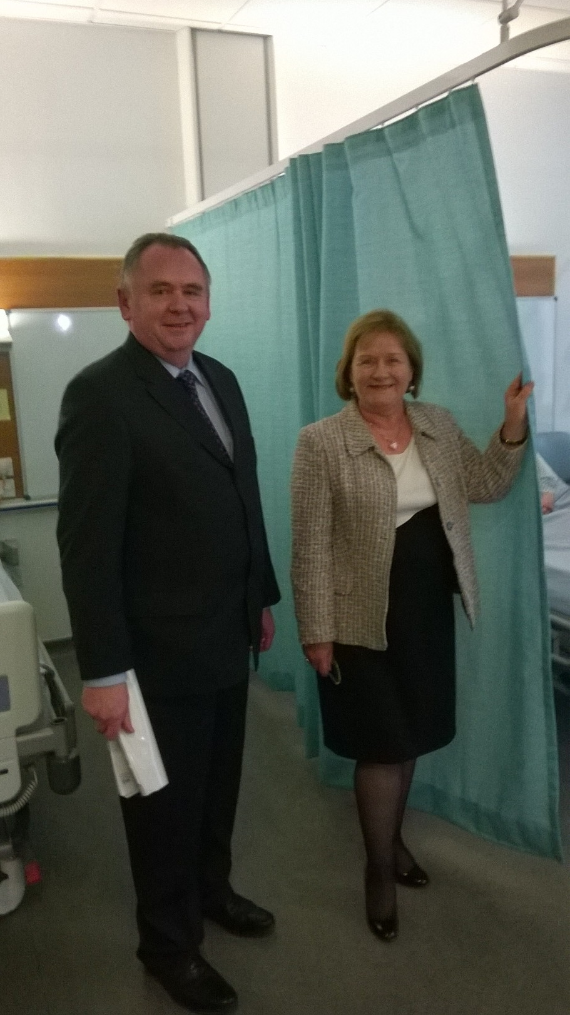
Ministerial launch

Slide 20
Campaign evaluation results
27% of respondents spontaneously mentioned creative
Good level of total campaign recognition
92% agreed the advert message was clear
Shift in attitude

Slide 21
Campaign media results
More TV spots meant more opportunities to see
Quality of airtime – centre ad breaks and position
STV Player Video On Demand (VOD)
Targeted drive time radio
High levels of interaction with microsite
Use of display banners
Feedback from NHS Boards

Slide 22
Thank you!
If you would like more details or just a chat, please contact me on:
  Email: jane.hoeflich@nhs.net
  Mobile: 07717 867 048
With thanks to Celia Gardiner and Lorna Renwick.

